Slide 1
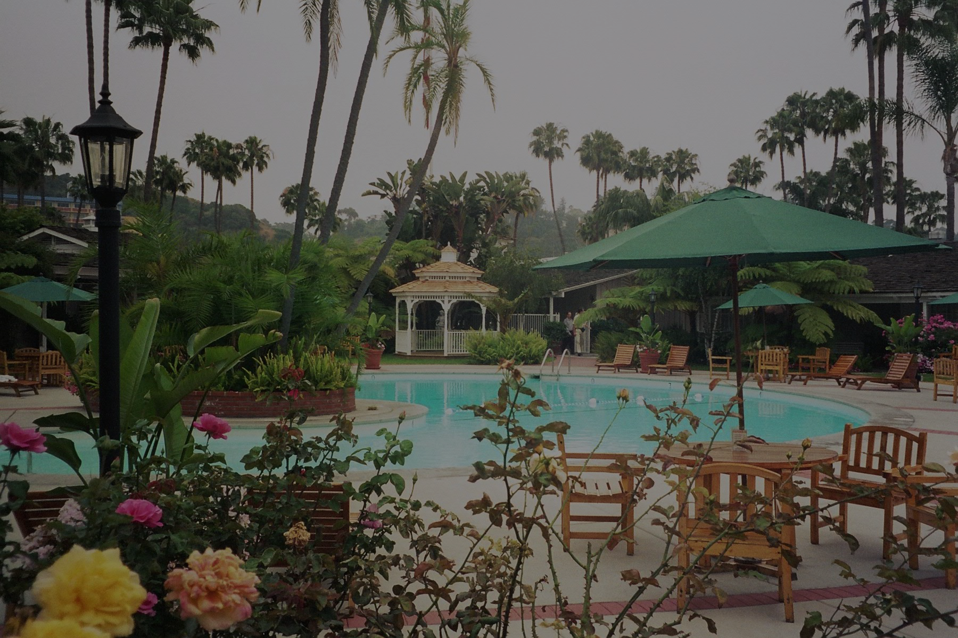

Christian Bedwell, Hunter Bedwell, Bryan Cordes, Benjamin Fulker, and Haley Ovenhouse
Notes:
Intro Slide
HALEY

Slide 2
Summary
HotSpot is a booking system for a single location, 6 bedroom resort located on the beach.
When HotSpot is ran, a window pops up for the user to login. This allows for administrators and staff to enter in their credentials in order to gain access to the system.
Both administrators and staff can make and quote bookings.
Only administrators can edit reservations, see client payment information, and print full report.
Staff can cancel reservations and look up reservations.
To book a reservation, the user simply has to log in, select a room, and then choose the dates they wish to stay on the calendar. Once they are to this point, the user is then asked for information such as first name, last name, credit card number, birth date, etc., which can be confirmed after form submission. From there the user is presented with a confirmation number.
Notes:
HALEY/HUNTER

Slide 3
Semester Efforts & Roles
Haley Ovenhouse - Team leader (Delegate task across group with internal set due dates, ensure completion of individual assignments and final product are on time, decide meeting times and agendas, and presentation and documentation work.)
Ben Fulker - Lead programmer (Code programs functionality and GUI. Assist in keeping documentation up to date.)
Bryan Cordes - Lead debugger/tester (Test code, identify bugs, fix bugs, and ensure functionality.)
Hunter Bedwell - Quality assurance (Ensure all documentation, requirements, presentations, and functionality is up to standards.)
Christian Bedwell - Project logistics manager (Responsible for documentation completion and aesthetics of program. )
Hours Spent : 5 hours requirements, 10+ hours analysis, 80+ hours coding, 20+ hours debugging/testing, 15+ hours documentation = 130+ hours
Lines of code : 5,500 (+-200)
Notes:
+4 hours of mental breakdowns!
HALEY

Slide 4
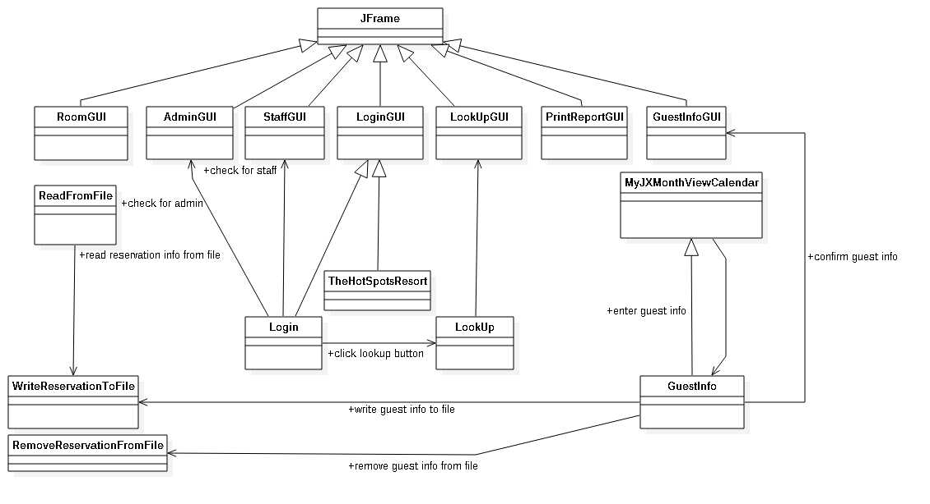
Design Overview
Notes:
CHRISTIAN

Slide 5
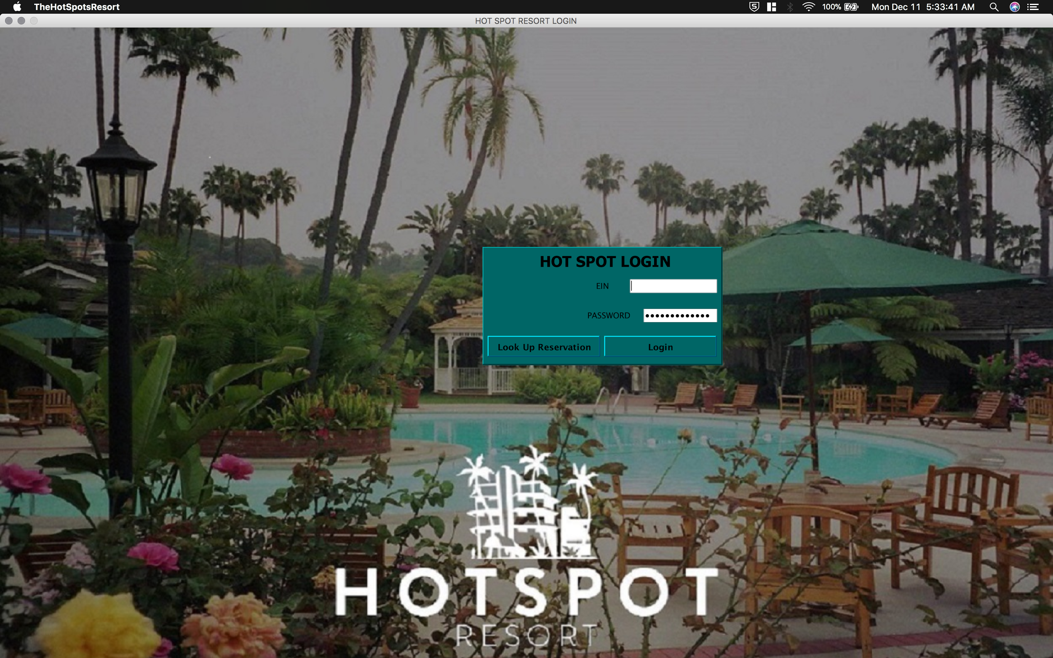
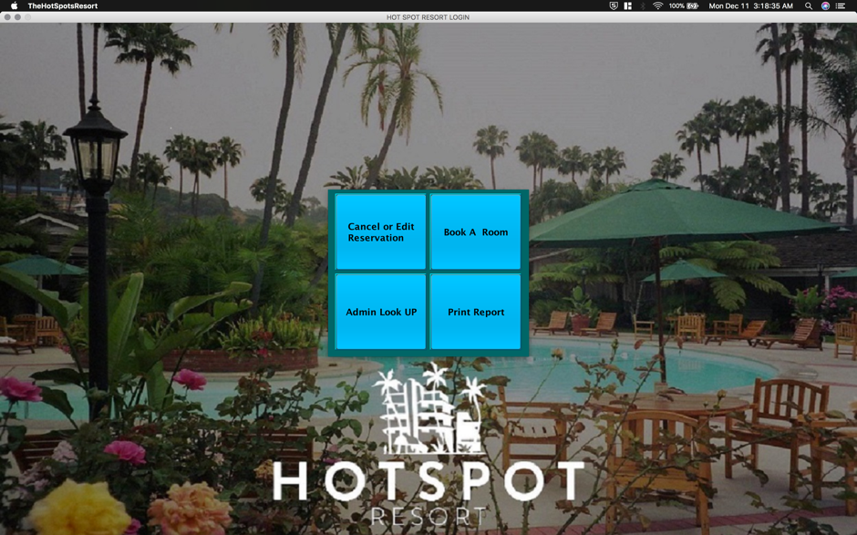
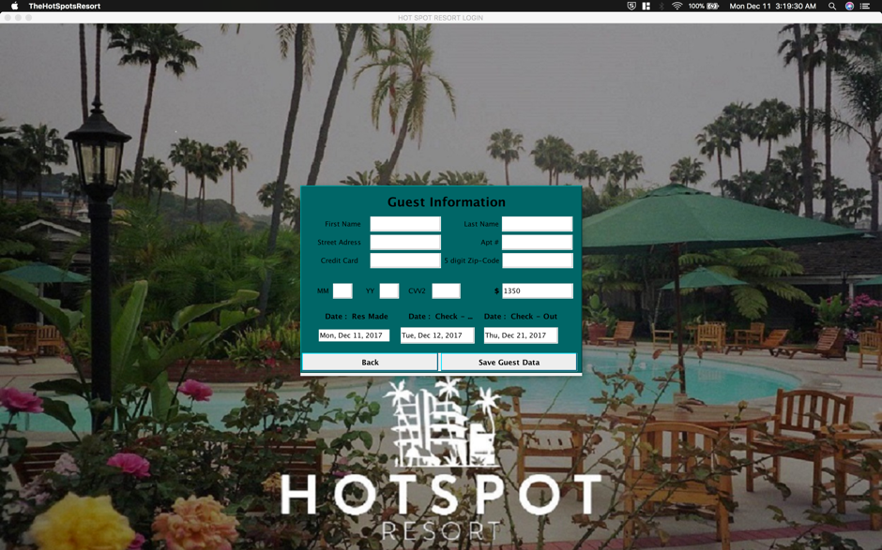
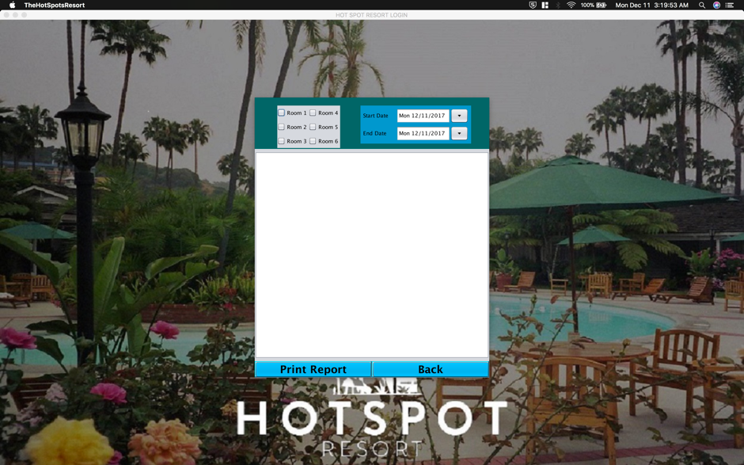
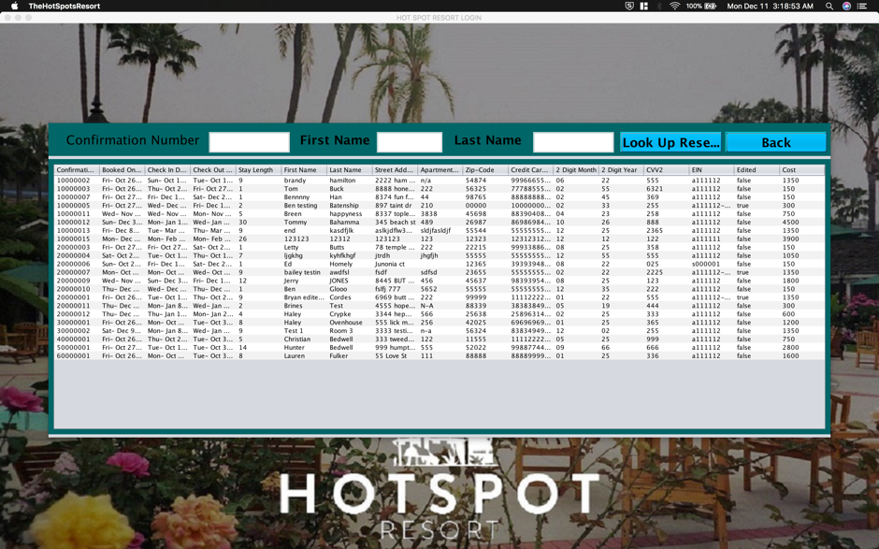
Images of Our Final Product
Notes:
BRYAN

Slide 6
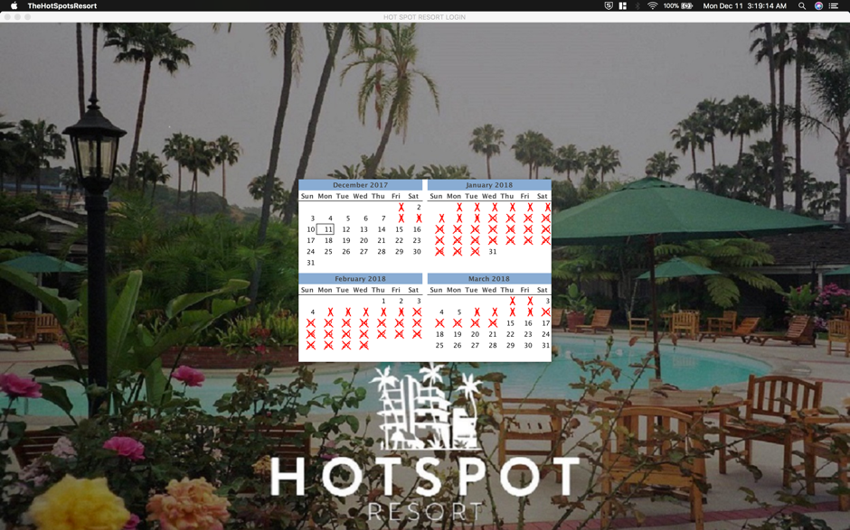
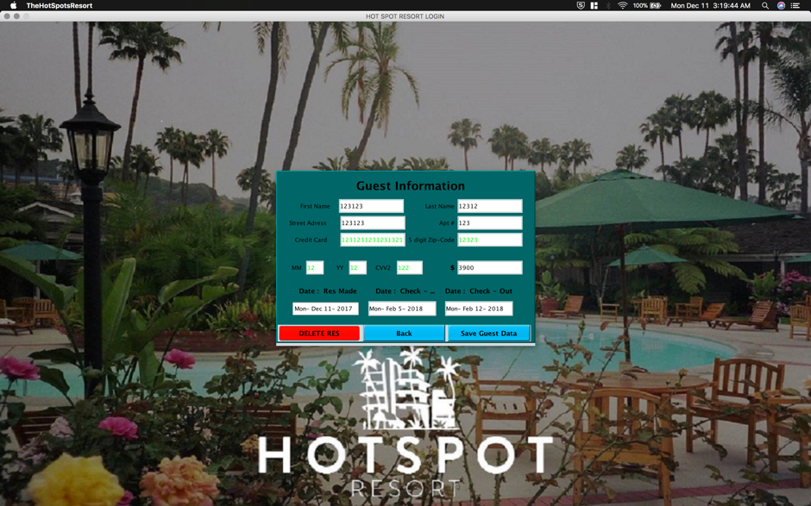

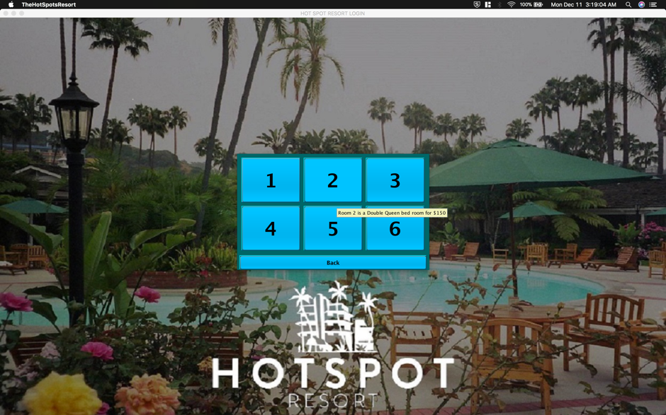
Images of Our Final Product (continued)
Notes:
BRYAN

Slide 7
Video Demo
Video Demo
Notes:
BRYAN

Slide 8
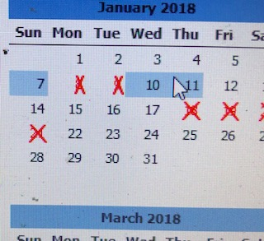
Test Results
Some of the major struggles we had with implementing our program were found while debugging.
I removed the logout button from the system as we couldn’t get it to work properly. I also had issue when user enters invalid login information I ended up restarting the system to reset the login page. This mean user will see the window open so you can see the window opening. We also corrected some major faults we found in testing. But while we were testing the logout button we kept have the jPanel wouldn’t come back when we set it’s visibility back to true.
Another issue was with our read from file then print based on certain criteria. Every time the lookup button was pressed it added every line in the text files over and over.
Another major area that had faults that were found with testing the date selection in our JXMonthView date-span date selection on instances with booking a reservation when the room adding in already booked reservations.
Notes:
BEN

Slide 9
The Legacy of Our Project
A known problems that we have with our program is the logout button. It wouldn't function properly. Jpanel with login data wouldn’t become visible when it was set to true. Attempts to resetting the data on the login screen after bad login information was entered, ended up just creating another instance of the loginGUI class and disposing of the old data.
Major challenges was with the database data being split, read, and matched against dates in a date range as we ending up having to print out each date in a reservation and checking it against all other booked reservations. We stored the check-in and check-out dates so comparing if 2 date ranges overlapped.
We were able to meet all of the requirements that were given to us by the product specifications and also the requirements we had set for ourselves in our shall statements. Being the first time that a majority of the group had worked with github and eclipse we faced challenges just being able to get each other code and being able to run and compile our code. Also, being that this was the first majorly large and high functioning program required of us in our curriculum, it was especially intimidating trying to wrap our heads around what all had to be done and how to implement it.
If we had it to do again, we most definitely would have used a screen recording software for the video of our prototype in the first presentation. From experience, I would recommend to future groups to make sure you have an open line of communication between the members of your group, a clear idea of what needs to be done, and to be sure to continually keep your project documentation up to date.
Notes:
BEN & HALEY

Slide 10
Thank You
&
Questions!
Notes:
HALEY

